Slide 1
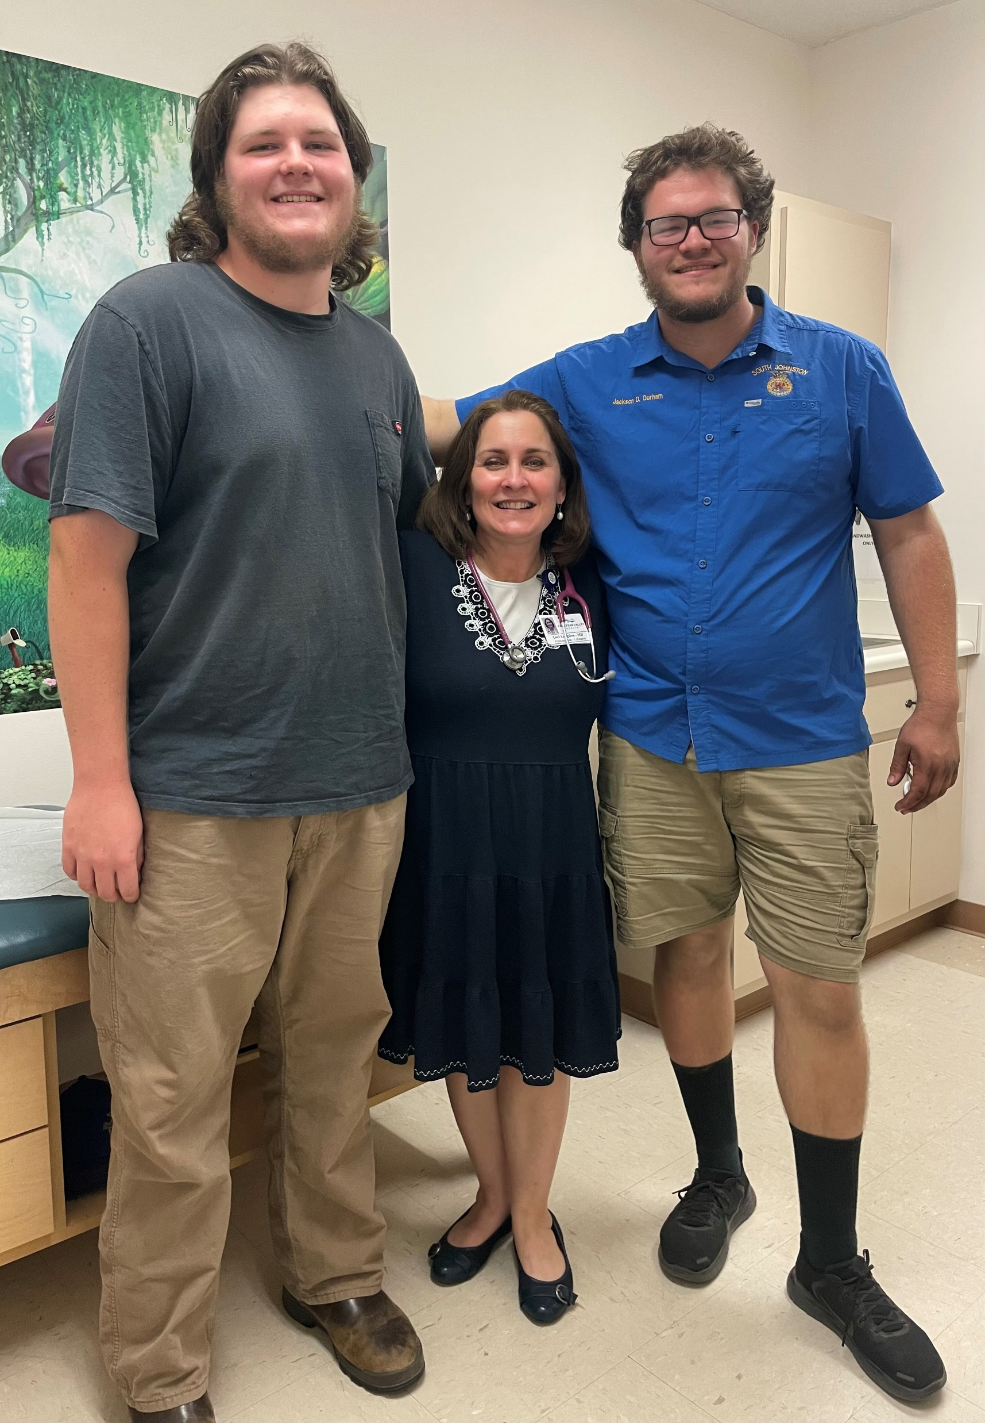
Welcome to Lightning Talks!
I am the Chair of Pediatrics
At the Campbell University
School of Osteopathic Medicine.
I have practiced pediatrics for
THIRTY years and decided to write
a book.
Notes:
I’m only 4’11”, so at least in pediatrics I can be taller than my patients. Well, sometimes.

Slide 2
Let’s Start at the Beginning
-I grew up on a farm, worked
in tobacco my entire childhood
-local public school system
was poorly resourced
-fortunately, my teen mom
knew TV was bad,
reading was good

Slide 3
My Secret to Catching up Academically
Notes:
My own guidance counselor told me that I couldn’t get into NCSSM coming from Coats.

Slide 4
Then on to College
-my major was Zoology
-extremely active in clubs
-extensive volunteering
-sought leadership positions
-took the MCAT junior year

Slide 5
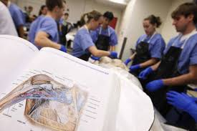
Next Step……Medical School

Slide 6
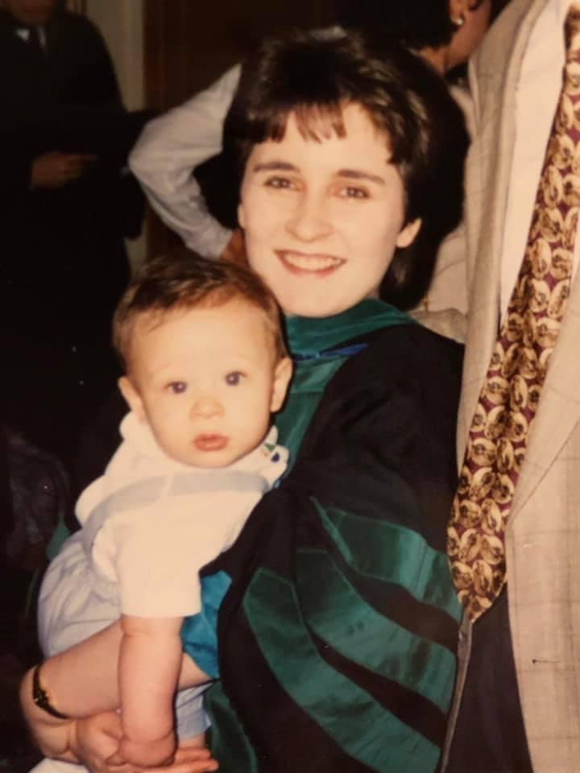

Slide 7
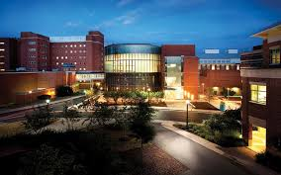
Then Residency……

Slide 8
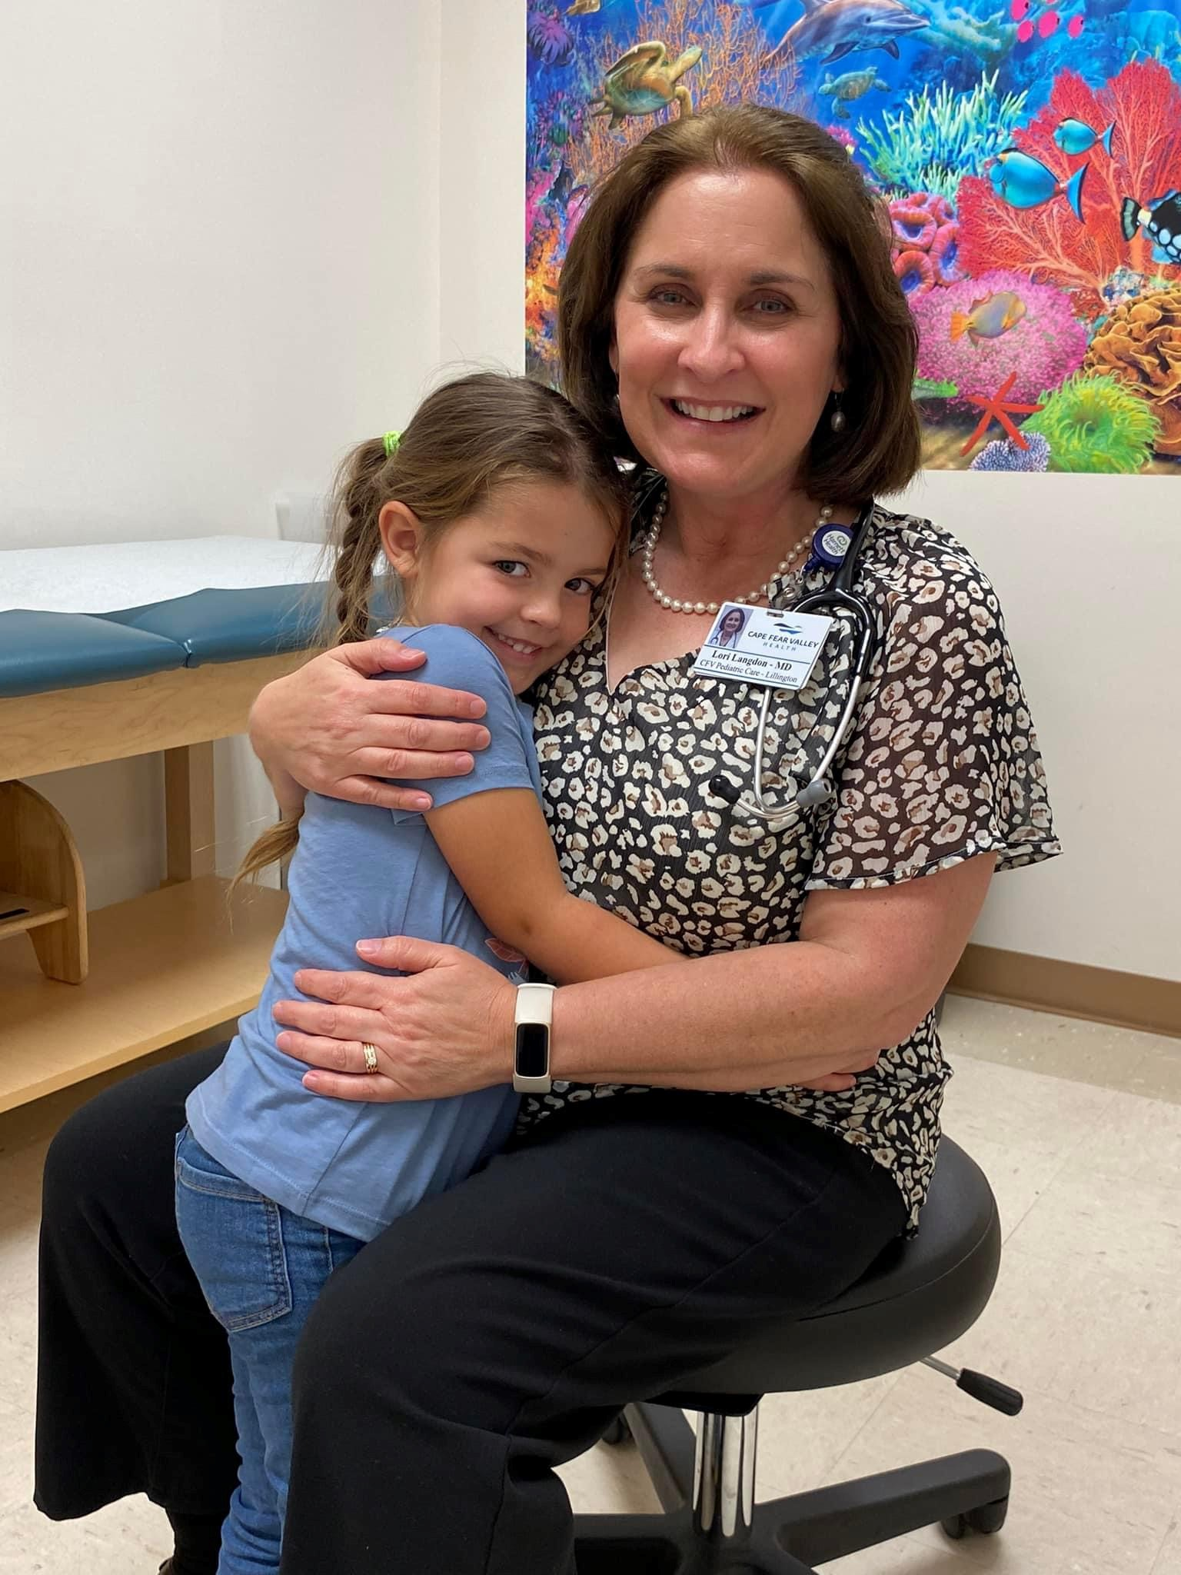
Why Do I Want to be a Pediatrician?
You could be a role model to a child!
-babies are adorable and their body fluids are less objectionable
-specific skill set
-preventive medicine at its finest
-truly comprehensive approach to care
-continuity of care
-many opportunities for education of families
-patients always deserve all that I can give them
-opportunities for inpatient/outpatient/generalist/specialist/academic
-vaccines are incredible
-many opportunities for community involvement/education/advocacy
-lots of reassurance only visits
-happy days depending on setting
-defender of children

Slide 9
Some Hard Things about Pediatrics
-some parents can be difficult or rude
-child abuse cases
-deaths are rare but devastating
-work-life balance not guaranteed
(especially in rural areas)
-prior authorizations, drug shortages
-anti-vaxxers
-staffing shortages
-poor reimbursements

Slide 10
Things Pediatricians Care About
-safety: car seats, swim lessons, sunscreen, helmets, safe storage of firearms
-well care: growth, development, heart healthy habits, vaccines, behavior, nutrition, dental hygiene
-mental health: depression, anxiety, sleep hygiene, ADHD
-treating illness: colds, ear infections, strep, always with judicious use of antibiotics
-teens: puberty, peer pressure, tobacco use, alcohol use, contraception, acne, academic performance

Slide 11
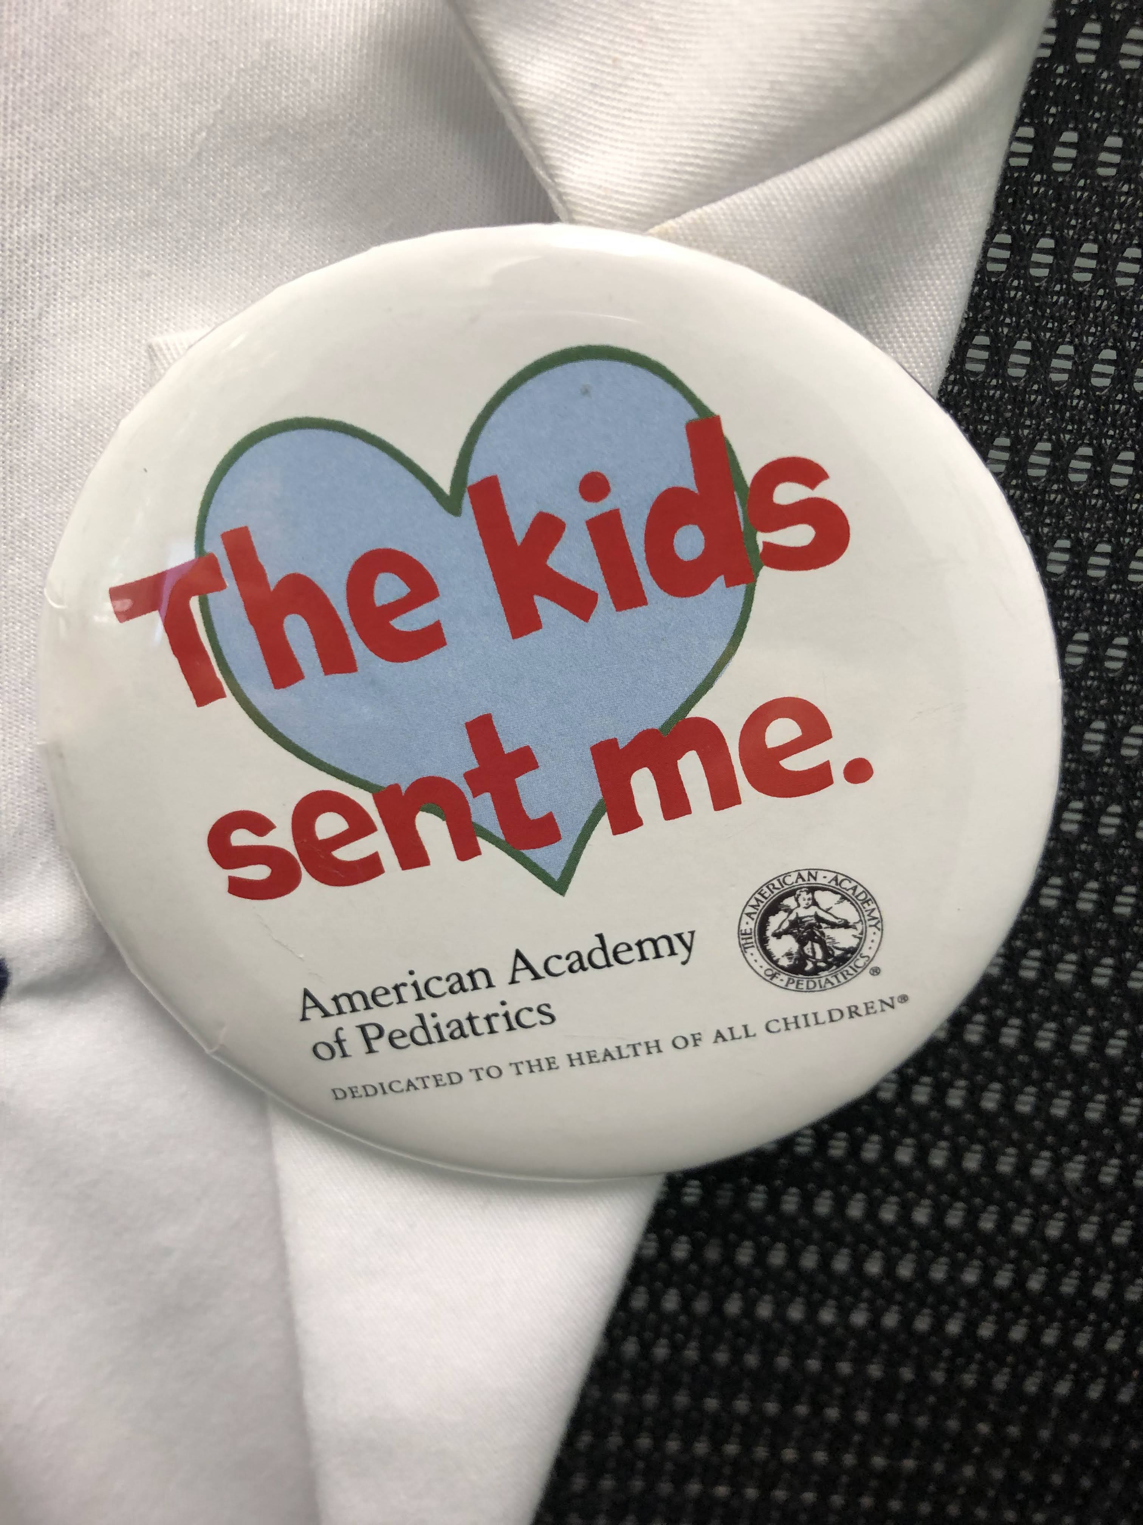
We also believe in ADVOCACY
Advocating for children can mean
a lot of different things:
-making a CPS report
-filling out paperwork for school
-going to the legislators to improve
various laws affecting children
-speaking at the School Board

Slide 12
Why write a book?

Slide 13
Lots of Reasons!
-wild things seem to happen to me
-young people in rural areas need to know they are good enough to accomplish their dreams
-we have a pediatrician shortage
-healthcare disparities in rural areas are worsening
-student doctors and women in medicine need encouragement

Slide 14
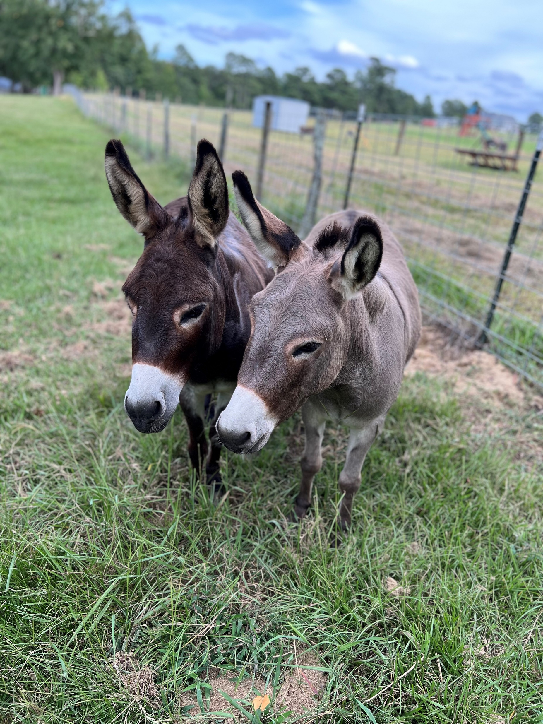
Please reach out!
My office is in Levine, 162.
My email is llangdon@campbell.edu
My YouTube channel is Doctor Langdon
I am kiddocontiktok

